Slide 1
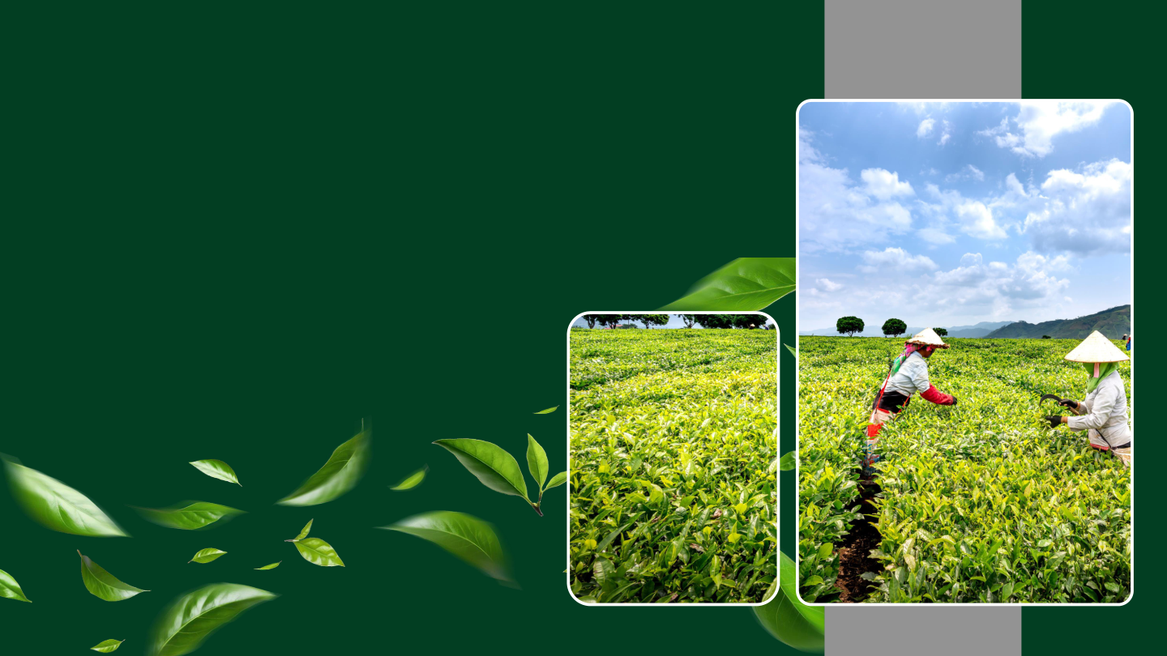
“Agri Twin AI – Risk-Aware Adaptive Farming Platform”
- BY team aetherix
Team Leader: C. Navienkumaar
Team Members:
1 . NAVIENKUMAAR C
2 . HARSHAVARDHINI M
3 . SIDDHARTH S
4 . MAHALAKSHMI S
5 . SHRI SHYAM A J
6 . NITISH NARAYANAN G

Slide 2

PROBLEM STATEMENT:
Farmers face uncertainty in crop yield and market demand due to changing weather, cultivation conditions, and market prices. There is a need for an AI-based forecasting system that combines historical, weather, crop, and market data. The system should predict future crop yield and market demand and identify potential supply–demand mismatches. This will support better production, crop planning, and distribution decisions

Slide 3

PROBLEM solution:
Agri Twin AI is an AI-powered smart agriculture platform that integrates IoT sensors, weather forecasting, market intelligence, and machine learning to support farmers in making data-driven decisions. The system continuously monitors field conditions such as soil moisture, temperature, and humidity, predicts crop yield and market demand, identifies potential risks, and recommends the most profitable crop. This helps farmers reduce losses, optimize resources, and improve overall productivity and profitability.

Slide 4

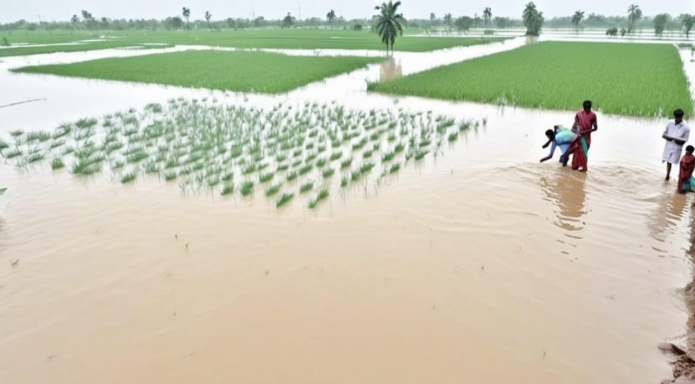
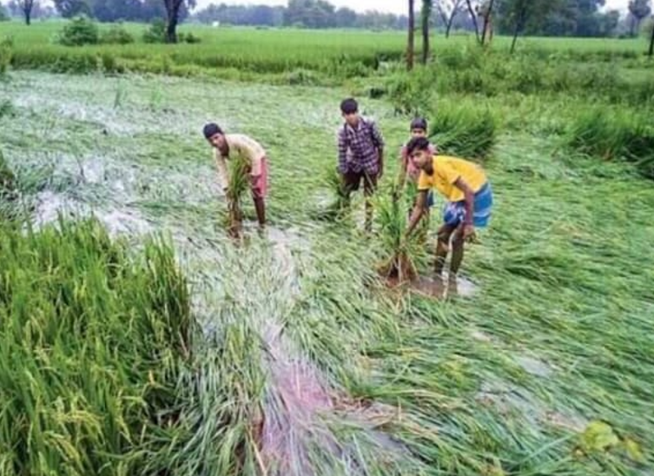
Feasibility:
⁕ Low-cost hardware
⁕ Available technologies
⁕ Real-time monitoring
⁕ Easy implementation
Viability:
⁕ Reduces crop losses
⁕ Improves farmer profitability
⁕ Saves resources
⁕ Scalable solution

Slide 5


IMPACT:
Improves Crop Productivity
Reduces Crop Losses
Supports Sustainable Farming
Improves Food Supply Planning
Supports Climate-Resilient Agriculture
BENEFITS:
Higher Farmer Profitability
Smart Irrigation
Real-Time Monitoring Better Market Decisions
Easy Decision Making

Slide 6

NOVELTY:
Integrated Supply–Demand Forecasting – Predicts both crop yield and market demand in one platform.
Profit-Based Crop Recommendation – Combines yield, price, and demand to suggest suitable crops.
Dynamic AI Re-Prediction – Continuously updates predictions using new sensor and weather data.
Multi-Risk Intelligence – Predicts flood, drought, disease, heatwave, and irrigation risks.
Unified Smart Farming Platform – Combines IoT + Weather + Market + AI for data-driven farming decisions.

Slide 7
THANK YOU
From AETHRIX

